Slide 1

CSE 400: Project and Thesis
On Detecting Malicious Code Injection by Monitoring Multi-level Container Activities
Presented By,
1705013 - Md. Olid Hasan Bhuiyan
1705034 - Souvik Das
Supervised By,
Dr. Md. Shohrab Hossain
Department of Computer Science and Engineering, Bangladesh University of Engineering and Technology

Slide 2
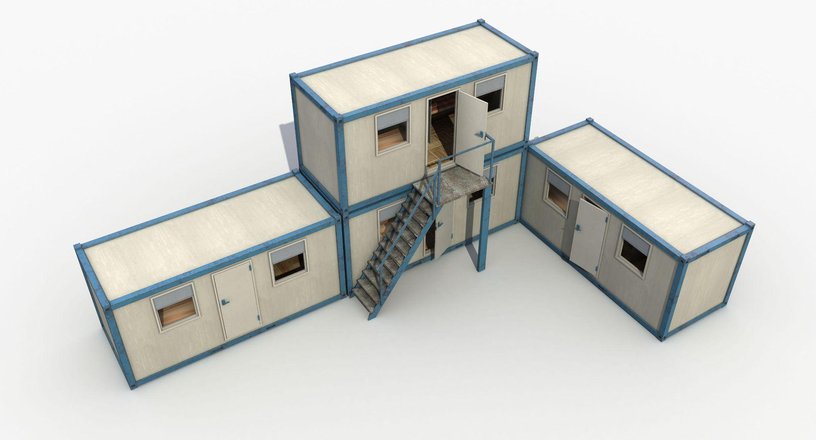
Container Issues
Security measure
(Door lock)
A temporary office built with several containers
Notes:
Let's say you're hosting a large outdoor event, and you've set up a number of shipping containers to serve as temporary offices, storage spaces, and restrooms. One day, a group of thieves breaks into the event grounds and gains access to the shipping containers. They realize that one of the containers contains valuable equipment, but it's locked with a sturdy padlock.
Instead of trying to break the lock, the thieves use a cutting torch to cut a hole in the side of the container. Once inside, they quickly grab the equipment and make their escape. The hole in the container is small enough that it's not immediately noticeable, and the theft goes undiscovered until the event is over.
In this scenario, the shipping container is analogous to a container in a software environment, and the padlock represents security measures such as access controls and authentication. The thieves' use of a cutting torch to bypass the lock is similar to an attacker exploiting a vulnerability or weakness in a container's security measures to gain unauthorized access to the underlying system or data. The theft itself is equivalent to data theft or a breach of sensitive information in a software environment.

Slide 3

Container Issues
How can I break in??

Slide 4


Container Issues
Found the weak point of a container!

Slide 5



Advantages
Disadvantages
Portable
Highly scalable
Isolated
Individual security mechanism
Multi-tenant service
Large attack surface
Communication complexity
Thin protection layer

Slide 6

What is a container?

Slide 7


What is a container?
“A lightweight OS-level virtualization method”
“Stand-alone piece of executable software”
“NOT a virtual machine”
“Process with isolation, shared resources and layered filesystem”

Slide 8
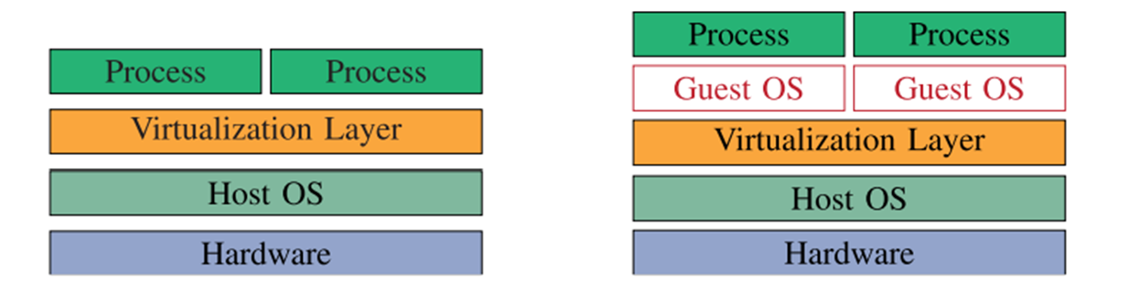
Container vs VM
Shared OS
Less secured
More suitable for microservice
Separate OS for each process
More secured
Less suitable for microservice
Container
VM

Slide 9

Problem Definition
Malicious code injection
A type of cyber attack where an attacker inserts malicious code into a vulnerable application or system, with the intent of compromising the security or functionality of the target.
There are several potential attack paths to insert malicious code into a container.
Notes:
Malicious code injection, also known as code injection attack, is a type of cyber attack where an attacker inserts malicious code into a vulnerable application or system, with the intent of compromising the security or functionality of the target. The injected code can be used to steal sensitive information, modify or delete data, gain unauthorized access to systems, or launch other types of attacks. Code injection attacks can occur through various means, such as through input fields, file uploads, or vulnerable APIs.

Slide 10
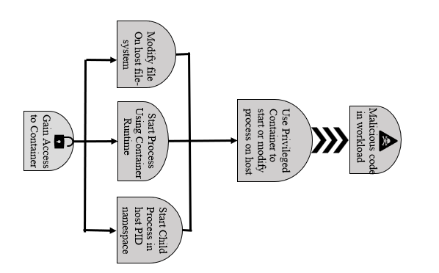
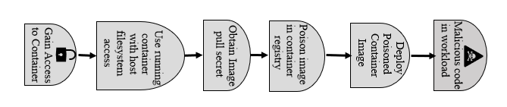
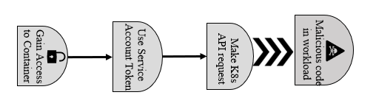
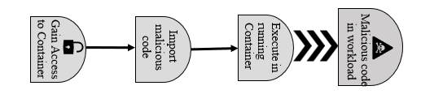
Problem Definition
Examples: XSS attack
SQLi attack
RBAC attack
CSRF attack

Slide 11





Our Goal
Our aim: Detecting malicious code injection in container for all potential attack paths
Achieved by:
Monitoring different levels of container
2. Fetching different features(name, sequence, frequency) of system calls
3. Using different tools like sysdig, strace and kubernetes dashboard

Slide 12
Motivation
Increasing usage of container technology and its weak security system
Malicious code injection is initiator to many other attacks
Malicious code injection is difficult to detect and fix due to complexity in container layering

Slide 13
Related Works
Limitations
Proposed a common solution - mostly using sequence of system calls
Abed et al. [1]
Suggested a host-based intrusion detection mechanism
Used BoSC(Bag of System Call) technique
Tool used: strace
Cavalcanti et al. [3]
Proposed a container-level anomaly-based intrusion detection systems for multi-tenant applications
Mainly worked on four different vulnerabilities - Authentication Bypass, DoS Overflow, System User Privilege Escalation and Integer Overflow
Tool used: sysdig
Did not cover all potential attack paths of malicious code injection

Slide 14
Related Works
Souppaya et al. [4]
Discussed the possible security issues raised by the usage of containers and offers suggestions for resolving them
Limitation
Did not implement their suggested methodology and evaluated it using any kind of performance metrics, let alone work on a specific attack signature
Yarygina et al. [9]
Proposed a flexible, cost-conscious intrusion response system for microservices that employs a game-theoretic method to automatically respond in real time to network threats
Sarkale et al. [10]
Suggested a new security layer using the Most Privileged Container (MPC)
MPC layer implements privilege-based access control and grants permissions for resource access based on rules

Slide 15
Gap Analysis
Using a general solution or detection mechanism for different types of attacks
Absence of attack specific detection mechanism
Some of the research works only proposed a methodology, did not even test their suggested method
None of these research works are related to multi-level protection in containerized environment

Slide 16
Proposed Approach
“To the mitigation of all the attack paths that finally leads to malicious code execution in container”
Our solution focuses on:
High efficiency
High scalability
Decent value of performance metrics (Precision, Recall, Accuracy and F1 score)
Must collect data (syscall features and activity log files) from different levels of container

Slide 17
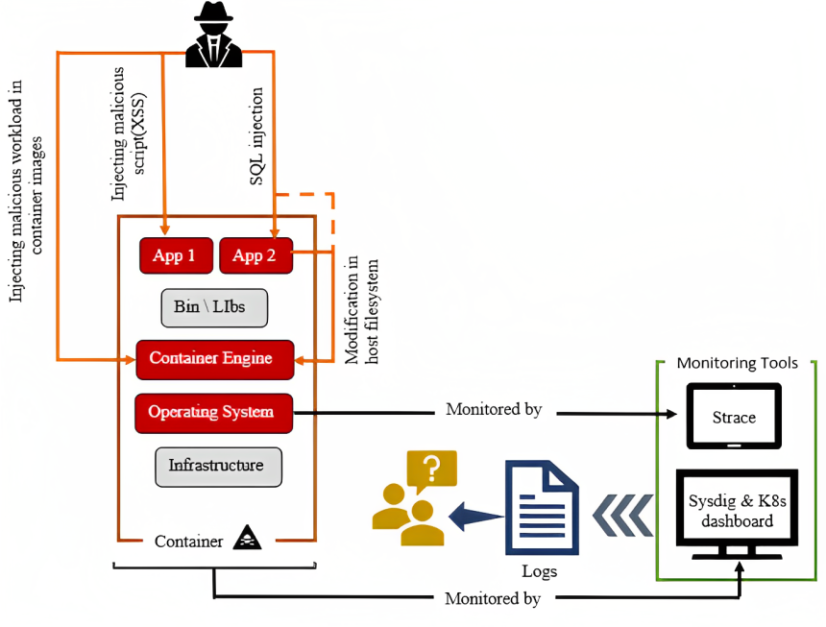
Proposed Approach
Reverse Engineering tool
Our proposed container monitoring system

Slide 18
Methodology
Steps
Simulate normal user activity on the container based applications
Simulate attack following the attack paths to inject malicious code
Collect container activities through syscall parameters and event logs
Malicious code injection detection using the benign behaviour model
Designing syscall parameter blueprint to detect malicious code injection
Syscall Filtering

Slide 19
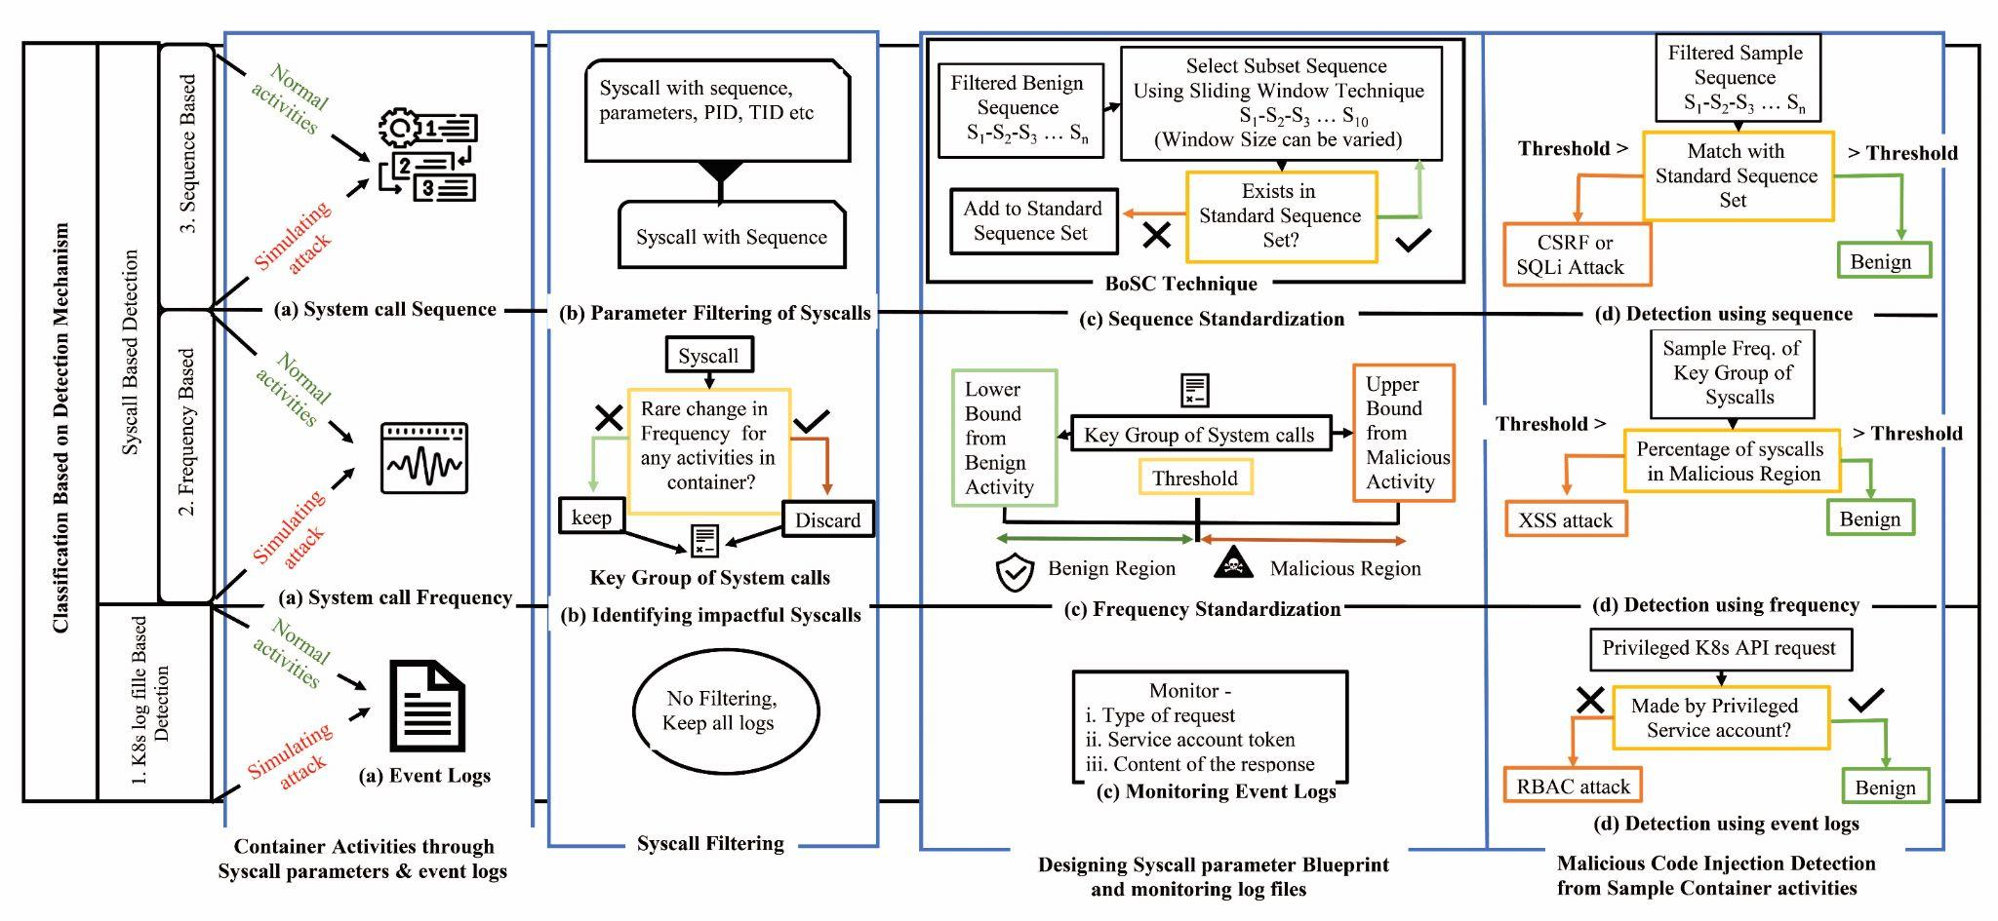
Methodology Overview

Slide 20
Methodology
Simulate normal user activity on the container based applications
Have simulated 4 different container based applications(based on seed-ubuntu)
To implement 4 different attacks(XSS, CSRF, SQLi and RBAC attack)
To generate data for benign activities
2. Tools and platform we used for our simulation are:
Operating system: Seed Ubuntu 20.04
Local kubernetes orchestrator: Minikube v1.28.0
Reverse engineering tools: Strace, Sysdig, Minikube dashboard

Slide 21
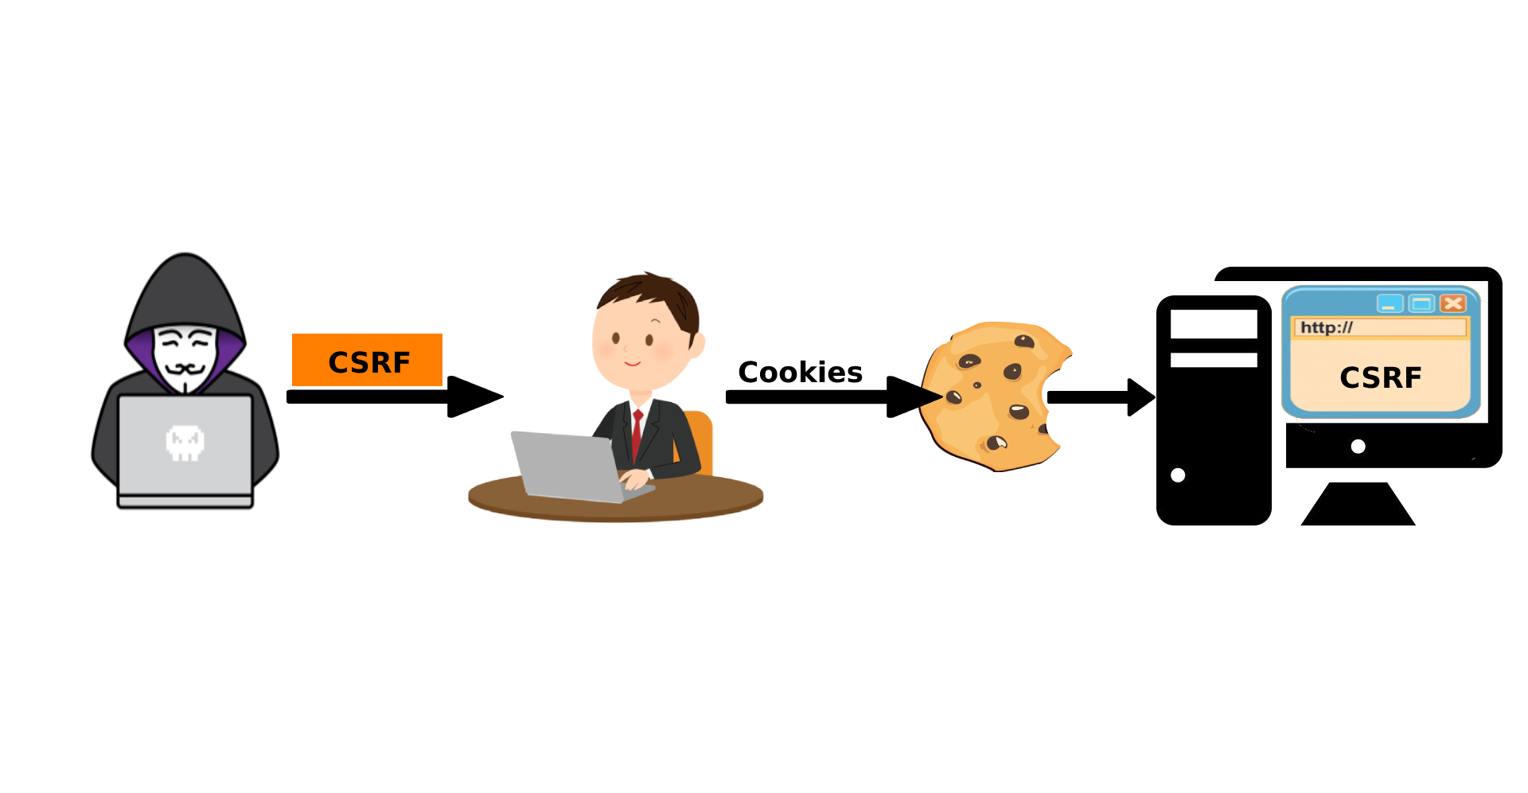

Methodology
Simulate attack following the attack paths to inject malicious code
CSRF attack
XSS attack

Slide 22
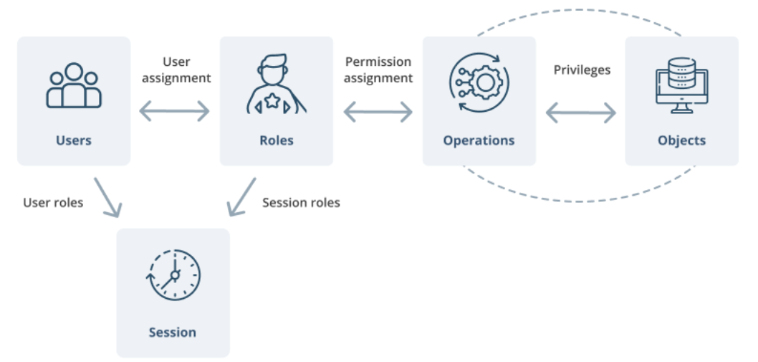
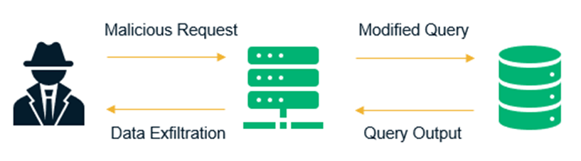
Methodology
Simulate attack following the attack paths to inject malicious code
SQLi attack
RBAC attack

Slide 23
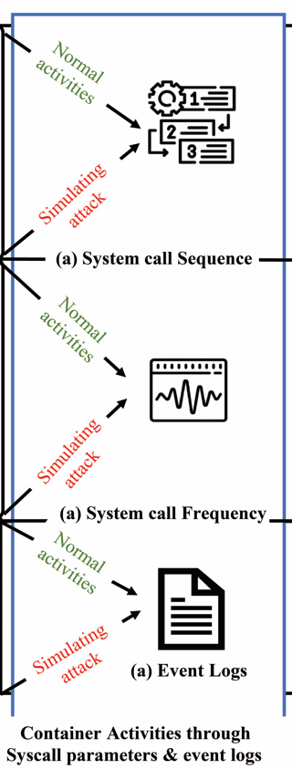
Methodology
Collect container activities through syscall parameters and event logs
Collect container activities expressed through different features of system calls like frequency, name and sequence
Gather event log files using minikube dashboard to track user activity

Slide 24
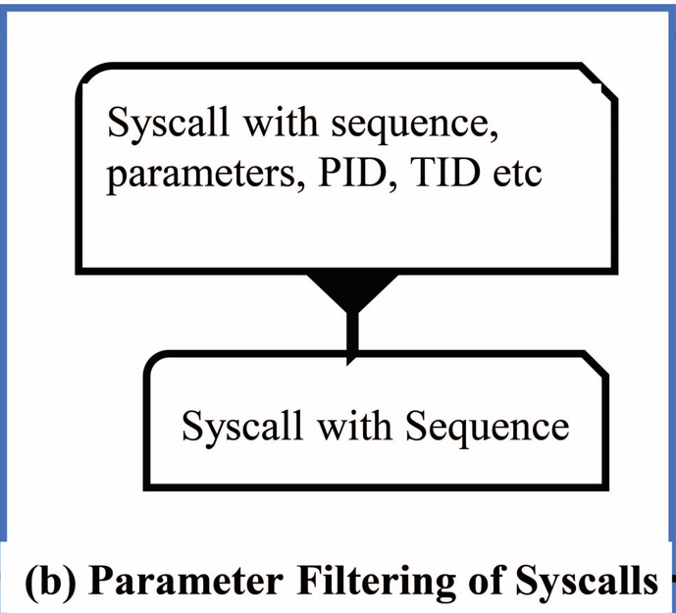
Methodology
Syscall Filtering
Using Sequence

Slide 25
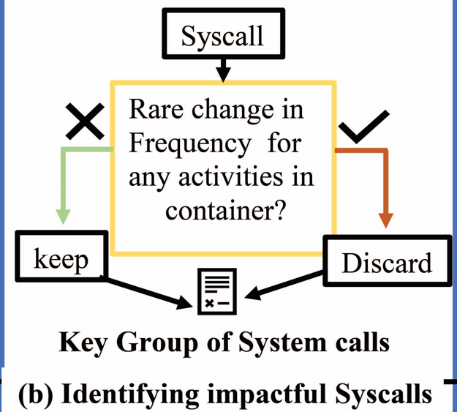
Methodology
Syscall Filtering
Using Frequency

Slide 26
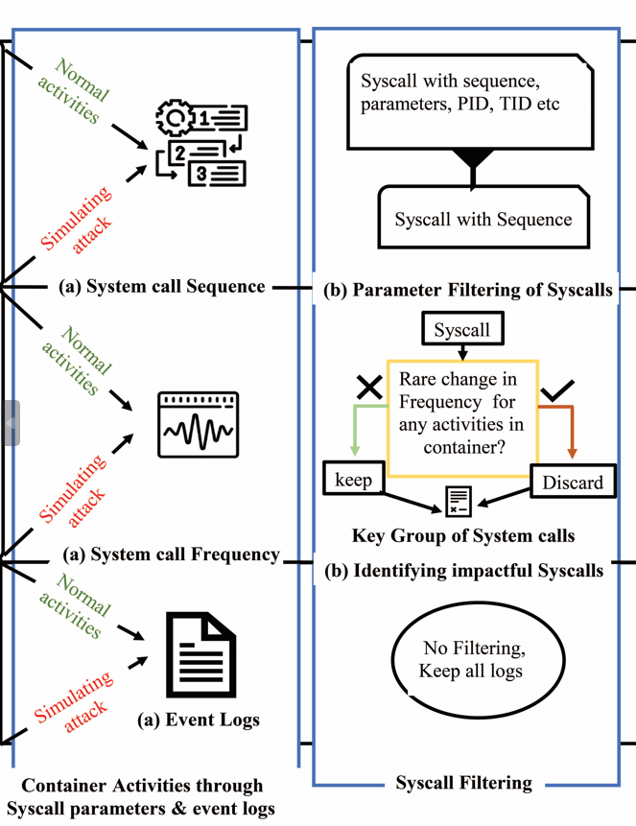
Methodology
Syscall Filtering

Slide 27
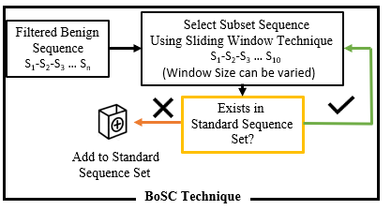
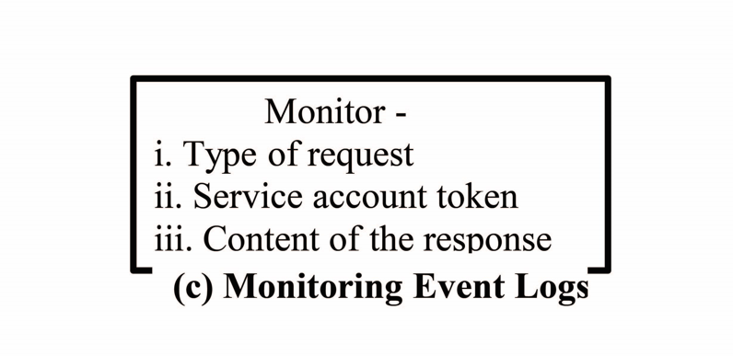
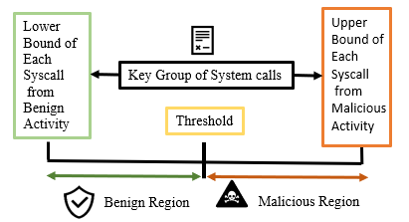
Methodology
Designing syscall parameter blueprint to detect malicious code injection
Frequency Standardization
Monitoring Event logs
Sequence Standardization

Slide 28
Methodology
Designing syscall parameter blueprint to detect malicious code injection
BoSC technique
S₁-S₂-S₃-S₄-S₅-S₆-S₇-S₈-S₉-S₁₀-S₁₁ … S_{n}

Slide 29

Methodology
Designing syscall parameter blueprint to detect malicious code injection
BoSC technique
If this sequence does not exist in benign sequence dataset, insert this sequence to this dataset
S₁-S₂-S₃-S₄-S₅-S₆-S₇-S₈-S₉-S₁₀-S₁₁ … S_{n}
S₁-S₂-S₃

Slide 30
Methodology
Designing syscall parameter blueprint to detect malicious code injection
BoSC technique
If this sequence does not exist in benign sequence dataset, insert this sequence to this dataset
S₁-S₂-S₃-S₄-S₅-S₆-S₇-S₈-S₉-S₁₀-S₁₁ … S_{n}
S₁-S₂-S₃
If this sequence already exists in benign sequence dataset, increase this sequence count by 1

Slide 31
Methodology
Designing syscall parameter blueprint to detect malicious code injection
BoSC technique
If this sequence does not exist in benign sequence dataset, insert this sequence to this dataset
S₁-S₂-S₃-S₄-S₅-S₆-S₇-S₈-S₉-S₁₀-S₁₁ … S_{n}
S₂-S₃-S₄
If this sequence already exists in benign sequence dataset, increase this sequence count by 1

Slide 32
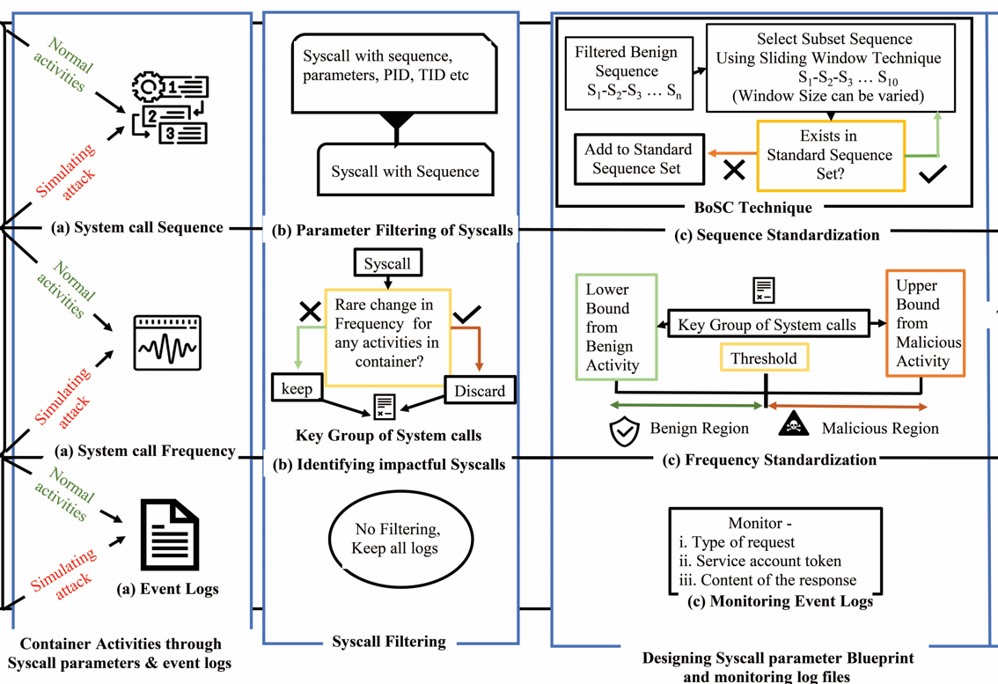
Methodology
Designing syscall parameter blueprint to detect malicious code injection

Slide 33
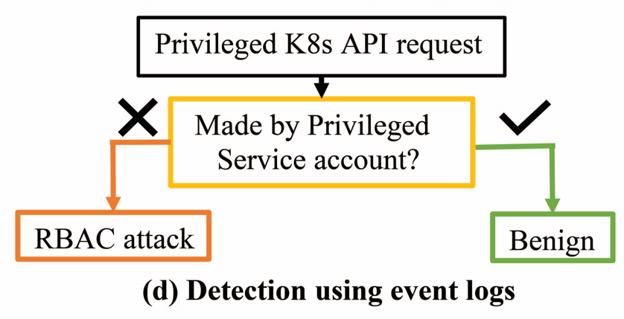
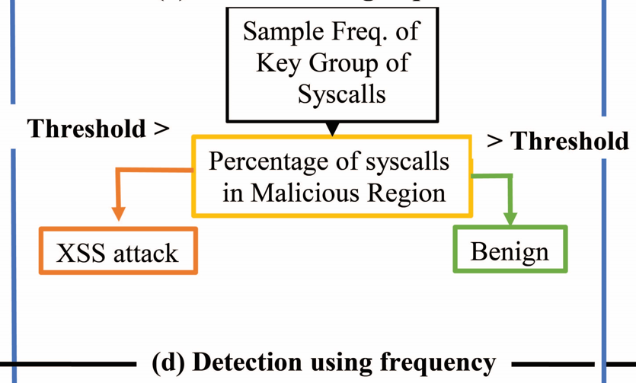
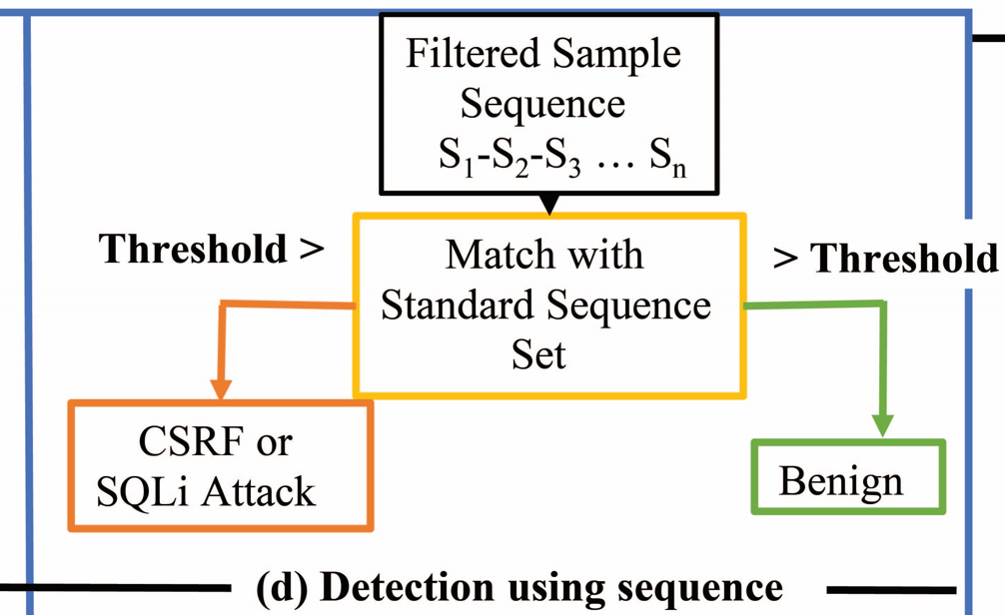
Methodology
Malicious code injection detection using the benign behaviour model
Detection using frequency
Detection using event logs
Detection using sequence

Slide 34
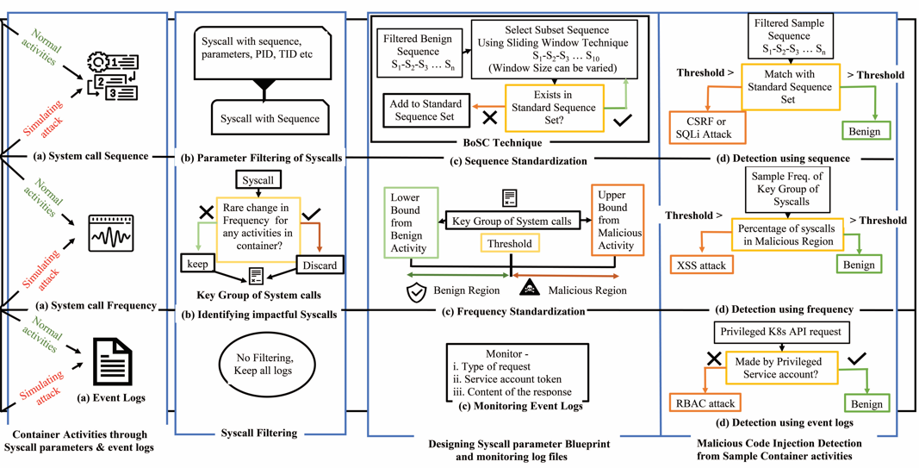
Methodology
Malicious code injection detection using the benign behaviour model

Slide 35
Methodology
Classification of our detection mechanism
We can classify our detection mechanism in two main classes:
K8s log file based detection
System call based detection
System call based detection can be divided into two more classes:
Sequence based detection
Frequency based detection

Slide 36
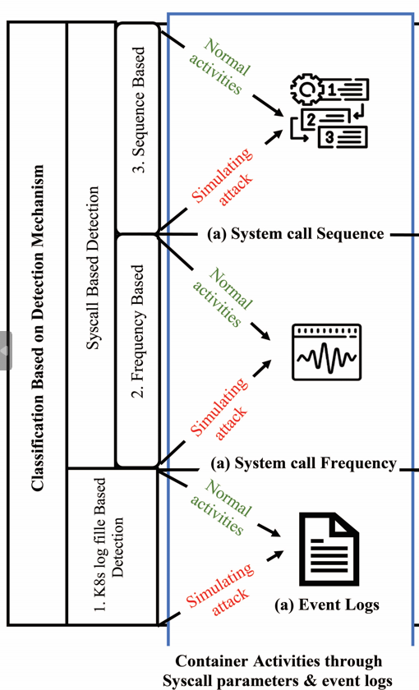
Methodology
Classification of our detection mechanism

Slide 37
Performance Evaluation
We are able to achieve decent score compared to the solution provided by Abed et al. [1] and Cavalcanti et al. [2]. The following performance metrics are used to evaluate our detection mechanism-
Precision
Recall
Accuracy and
F1 score

Slide 38
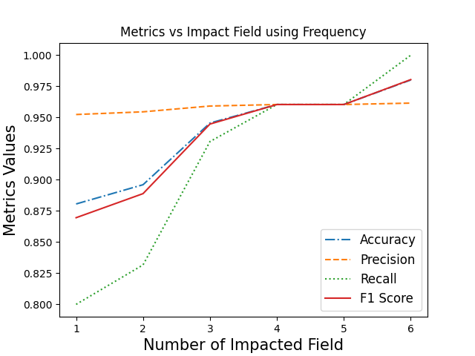
Performance Evaluation
Performance metrics using Frequency
# of Impacted field(i.e,attack severity)
Performance

Slide 39
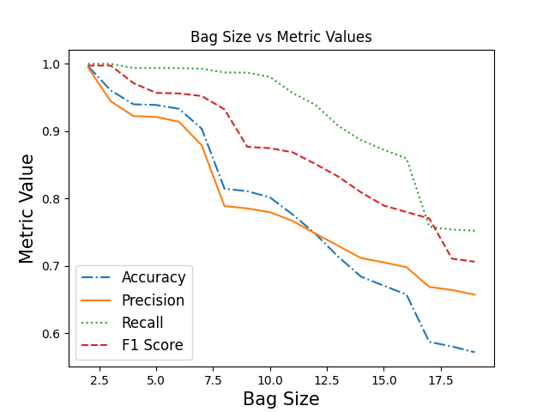
Performance Evaluation
Performance metrics using Frequency
Performance metrics show decent scores for a bag size of 2 to 6

Slide 40
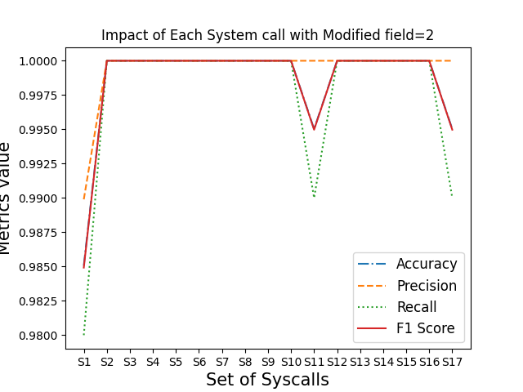
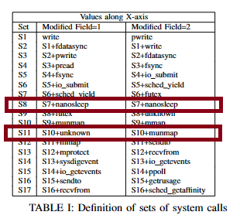
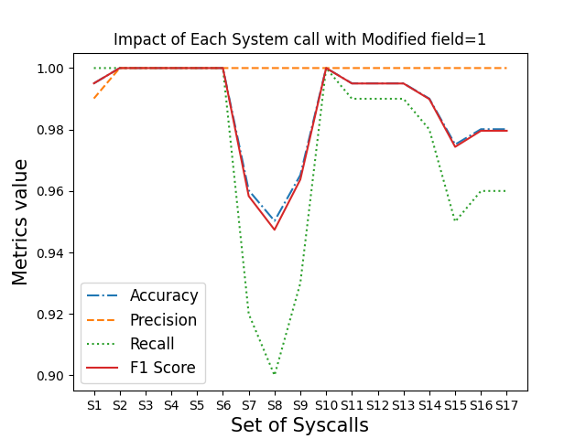
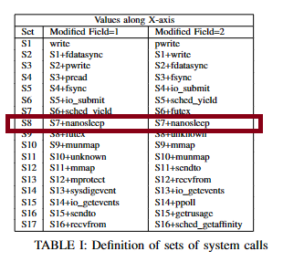
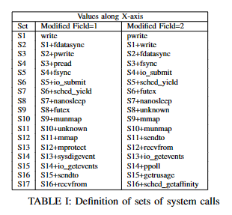
Performance Evaluation
Identifying key group of system calls

Slide 41
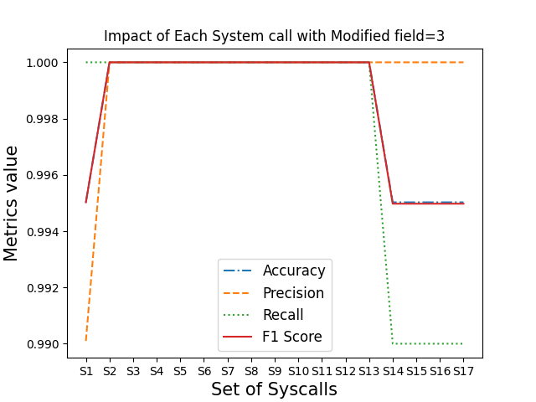
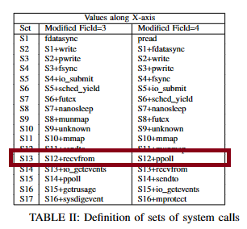
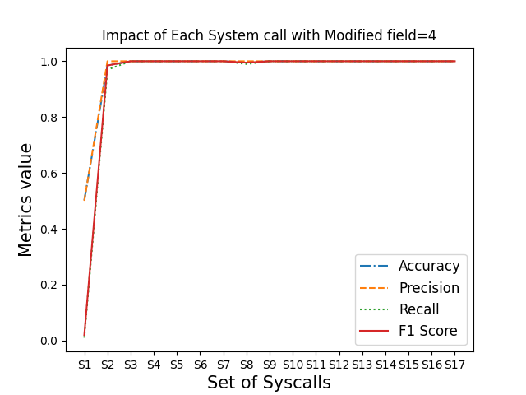
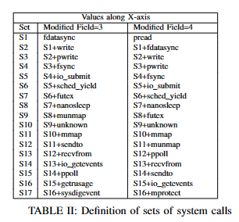
Performance Evaluation
Identifying key group of system calls

Slide 42
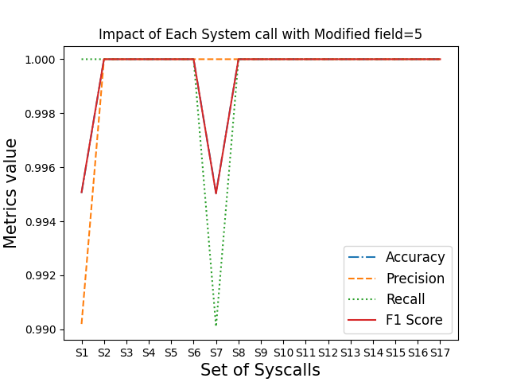
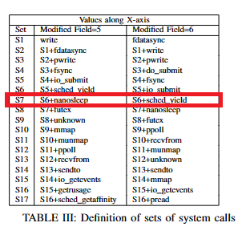
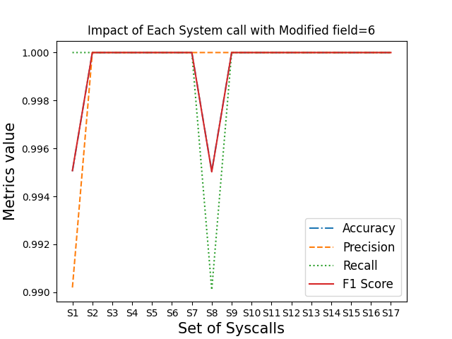
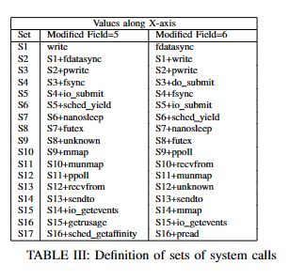
Performance Evaluation
Identifying key group of system calls

Slide 43
Our Contribution
Multi-level monitoring of container using different monitoring tools
Makes it feasible to identify an attack in a different level if an attacker manages to get past a single layer of a container without being detected
Path Specific detection mechanism
Covers lots of potential ways to inject malicious code in a container
Identifying Key group of system calls
Have increased the efficiency of our detection mechanism as we are no longer concerned about unnecessary system calls

Slide 44
References
A. S. Abed, T. C. Clancy, and D. S. Levy, “Applying bag of system calls for anomalous behavior detection of applications in linux containers,” in 2015 IEEE globecom workshops (GC Wkshps). IEEE, 2015, pp. 1–5
G. R. Castanhel, T. Heinrich, F. Ceschin, and C. Maziero, “Taking a peek: An evaluation of anomaly detection using system calls for containers,” in 2021 IEEE Symposium on Computers and Communications (ISCC). IEEE, 2021, pp. 1–6
M. Cavalcanti, P. Inacio, and M. Freire, “Performance evaluation of container-level anomaly-based intrusion detection systems for multi-tenant applications using machine learning algorithms,” in Proceedings of the 16th International Conference on Availability, Reliability and Security, 2021, pp. 1–9
M. Souppaya, J. Morello, and K. Scarfone, “Application container security guide,” National Institute of Standards and Technology, Tech. Rep., 2017
X. Lin, L. Lei, Y. Wang, J. Jing, K. Sun, and Q. Zhou, “A measurement study on linux container security: Attacks and countermeasures,” in Proceedings of the 34th Annual Computer Security Applications Conference, 2018, pp. 418–429
J. Chelladhurai, P. R. Chelliah, and S. A. Kumar, “Securing docker containers from denial of service (dos) attacks,” in 2016 IEEE International Conference on Services Computing (SCC). IEEE, 2016, pp. 856–859

Slide 45
References
7. O. Tunde-Onadele, J. He, T. Dai, and X. Gu, “A study on container vulnerability exploit detection,” in 2019 ieee international conference on cloud engineering (IC2E). IEEE, 2019, pp. 121– 127.
8. T. Bui, “Analysis of docker security,” arXiv preprint arXiv:1501.02967, 2015.
9. T. Yarygina and C. Otterstad, “A game of microservices: Automated intrusion response,” in Distributed Applications and Interoperable Systems: 18th IFIP WG 6.1 International Conference, DAIS 2018, Held as Part of the 13th International Federated Conference on Distributed Computing Techniques, DisCoTec 2018, Madrid, Spain, June 18-21, 2018, Proceedings 18. Springer, 2018, pp. 169–177.
10. V. V. Sarkale, P. Rad, and W. Lee, “Secure cloud container: Runtime behavior monitoring using most privileged container (mpc),” in 2017 IEEE 4th International Conference on Cyber Security and Cloud Computing (CSCloud). IEEE, 2017, pp. 351–356.
11. S. A. Hofmeyr, S. Forrest, and A. Somayaji, “Intrusion detection using sequences of system calls,” Journal of computer security, vol. 6, no. 3, pp. 151–180, 1998
12. L. Kuang and M. Zulkernine, “An intrusion-tolerant mechanism for intrusion detection systems,” in 2008 Third International Conference on Availability, Reliability and Security. IEEE, 2008, pp. 319–326.

Slide 46
This is a collaborative work with Concordia University, Canada
This research is funded by RISE Internal Research Grant

Slide 47
THANK YOU

